Slide 1
Disaster Recovery Approaches
V 3.0

Slide 2
Common DR Approaches
Cold DR Site
Warm DR Site
Hot DR Site

Slide 3
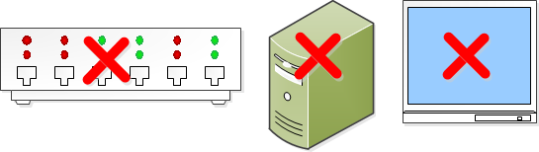
Cold DR Site
Power, cooling, connectivity available
No other equipment
RTO > Days

Slide 4
Warm DR Site
Equipment available
Recovery from backups/Replicated Storage
Tape
D2D
Storage
RTO > Many hours

Slide 5
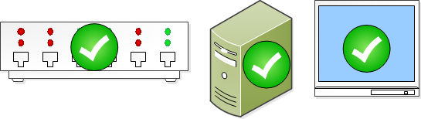
Hot DR Site
Equipment available

Slide 6
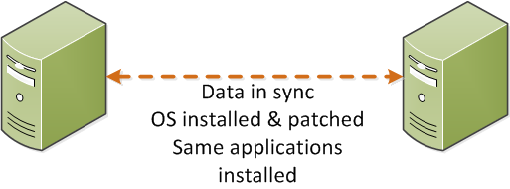
Hot DR Site
Ready state servers
Data replicated

Slide 7
Hot DR Site
RTO = 0 min ≤ X minutes
RPO = 0 min ≤ X minute

Slide 8
Common DR Approaches
Only warm and hot standby DR approaches are considered!!!!

Slide 9
Common DR Architectures Data Availability
Ship Backup Tapes to off-site/on-site DR Location – Warm
Block-based Storage Replication (Storage Array based & LUN2LUN) – Warm/Hot
Application Based Replication (Server based: Log shipping, mirroring) – Hot
Notes:
Server-based also employs host LVM replication at block level, synch or asynch
Application Log shipping and mirroring are done at host level and uses local host resources
Frame-based or Array based uses array operation environment and resources

Slide 10
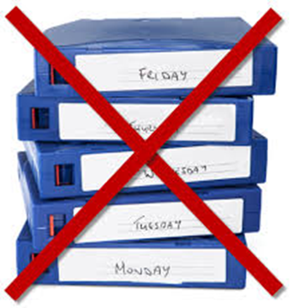
DR Using off-site/on-site Tapes Warm DR Site
Pros
Cons
High Transactional Integrity
Long RTO
Build and Restore
Long and Manual Process
Complex
Notes:
Currently, we validate DR preparedness

Slide 11
Block-based Storage Replication Warm DR/Hot Site
Data is synchronized between production and DR sites using storage array replication(e.g. 3PAR StoreServ)
In the event of failure at the Prod site, data is available at DR site (Synch/Asynch Repl.)
Notes:
Currently, we validate DR preparedness
Passive or Active DR environment not available

Slide 12
Block-based Storage Replication Warm/Hot DR Site
Transactional Integrity View of Application Data

Slide 13
Block-based Storage Replication Warm/Hot DR Site
Transactional integrity are two different things at Block and Database levels. Data could be in synch at Block-level but may not be in synch at application level
Notes:
We will know about Trans. integrity when we will recover replicated DB at block level on newly build physical and/or virtual server.
Should be tested a number of times to see DB comes in healthy state all the times!!

Slide 14
Application Level Replication Hot DR Site
Uses Native Application Tools
Examples:
SQL AAG stretch across WAN/DC
SQL Mirroring
SQL Transaction Replication
SQL Log Shipping

Slide 15
Application Level Replication Hot DR Site
Uses Native Application Tools
More Examples:
Exchange 2010 and 2013
Database Availability Group (DAG) can replicate active DB copies to replica copies
Stretch DAG across Sites (need <500 ms round trip latency?)

Slide 16
Application Level Replication Hot DR Site
Pros
Cons
Application transactional integrity maintained
Low RTO and RPO
Business availability
Easy and faster DR
Ready state servers required
High network bandwidth
$$$ - Same infrastructure required at DR site

Slide 17
Healthfirst DR Approach
Leveraging StoreOnce/DataProtector VTL & Physical Tape → Warm DR
Leveraging StoreServ to StoreServ Replication B/W NJ & FL → Warm DR
Build and Standup a Standby DR environment at GW – FL → Hot DR (FMO?)

Slide 18

DR Leveraging StoreOnce/DataProtector VTL & Physical Tape → Warm DR
This is current DR strategy
November 2016 DR drill will leverage StoreOnce VTL and DataProtector for a warm DR scenario

Slide 19
DR Leveraging StoreOnce/DataProtector VTL & Physical Tape → Warm DR
Pros
Cons
CL – NJ StoreOnce replicates backup data to GW – FL StoreOnce
D2D VTL tapes available at GW – FL
TSM Physical Tapes
Time Consuming
Build physical servers, apply patches, install application
Attach servers to StoreServ LUNs
Restore data from StoreOnce to physical server
Restore data form TSM physical tapes or VTL where applicable

Slide 20
DR Leveraging StoreOnce/DataProtector VTL & Physical Tape → Warm DR
Pros
Cons
VM can be recovered using DataProtector & and replicated VM on StoreOnce
VM has to be selected, backed up and restored before actual disaster!!!!
After VM is brought online, update IP and flush DNS

Slide 21

DR Leveraging StoreServ to StoreServ Replication B/W NJ & FL → Warm DR
This was the operational go-forward approach for 2016 DR drill for a warm DR scenario
On hold at this time because of BW issue between CL – NJ and GW - FL

Slide 22
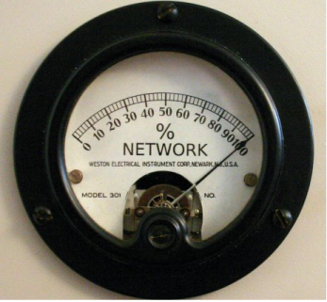
DR Using 3PAR StoreServ Replication Warm DR
Pros
Cons
Independent of host server (H/W, OS, Application)
High network bandwidth
5.7 TB of changed data in 24 hours will consume 0.54 Gbps between 3PAR to 3PAR
~ 1/2of available BW

Slide 23

DR Using 3PAR StoreServ Replication Warm DR
Pros
Cons
Complete data available at DR site with block level storage consistency
Time consuming
Build servers, patch, install apps and attach to storage
VM’s at DR site could be recovered using DataProtector
Manual switch over (if sophisticated vendor tools not available)

Slide 24
DR Using 3PAR StoreServ Replication Warm DR
Pros
Cons
Block-level StoreServ to StoreServ replication
Complete data available at DR site with block level storage consistency
Transactional integrity cannot be guaranteed at the application level because DB and log files could be locked by the application
No protection against user and software errors (point-in-time recovery). Fallback to backups
Potentially high RPO

Slide 25
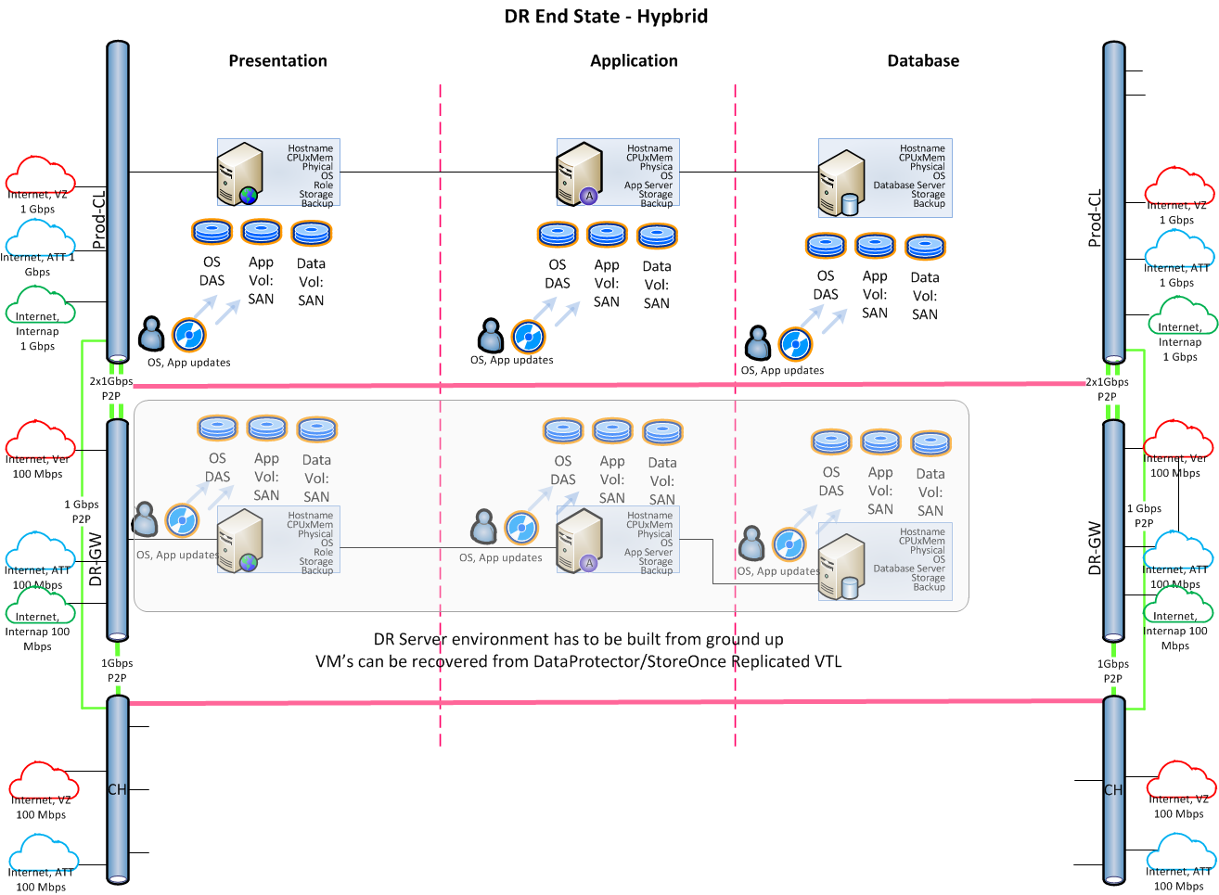
DR Using 3PAR StoreServ Replication Warm DR

Slide 26

Build and Standup a Standby DR Environment – Hot DR (FMO)
This approach calls for a standby DR environment
Servers are prebuilt and kept up to date at OS and application level
Data is kept in synch using LUN 2 LUN replication
Approach is undecided!!

Slide 27
Build and Standup a Standby DR Environment – Hot DR
Pros
Cons
Provides optimum BCP
Provide ideal RTO and RPO
DR environment is created based upon an application’s business tier requirements
Does not call from whole array to array replication which consumes more available bandwidth
Can be fully automated using DNS load balancing for A/P and A/A application availability
Business can do DR test at their convenience as DR environment is always available
DR environment may be used for Dev (stop repl.) and reporting
Require replica hardware based upon application’s RCO
Initial long setup time – build two environments, prod and DR
Initial high $$$ cost
High on-going maintenance cost

Slide 28
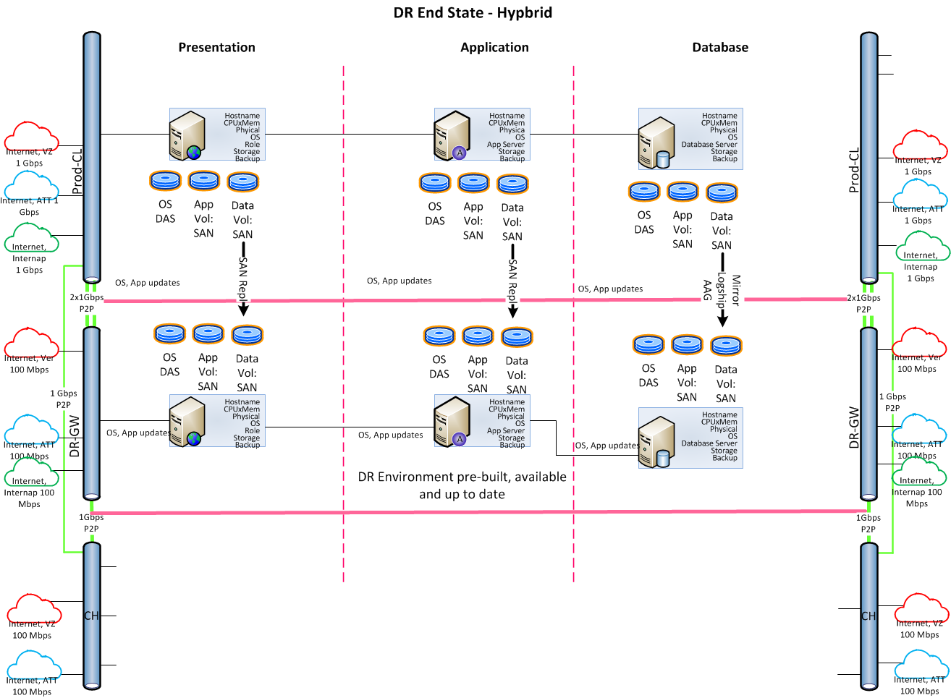
Build and Standup a Standby DR Environment – Hot DR

Slide 29
End-state Comparison
DR Using Storage Replication, VTL, Tapes - Warm DR
Build and Standup a Standby DR Environment – Hot DR
Time consuming. Build in scope server environment from ground up.
Patch servers, install & update applications
Application transactional integrity in question with storage replication
Complex and manual process if not supported by vendor tool
Less on-going maintenance for warm DR
DR Environment pre built, up to date and available
VM’s can be restored from replicated VTL. Manual steps involved
Application transactional integrity guaranteed by application
Relatively easy to setup but require replica hardware based upon RCO
High ongoing maintenance cost
Initial long setup time

Slide 30
End-state Comparison
DR Using Storage Replication, VTL, Tapes - Warm DR
Build and Standup a Standby DR Environment – Hot DR
Can be fully automated using vendor tools (for hot DR)
Storage Array to Array replication may consume more available bandwidth
Can be fully automated using DNS load balancing for A/P and A/A application availability leveraging skills at hand
Business can do DR test at their convenience as DR environment is always available
LUN 2 LUN per server replication consumes less available bandwidth
DR environment may be used for Dev (stop repl.)

